Slide 1
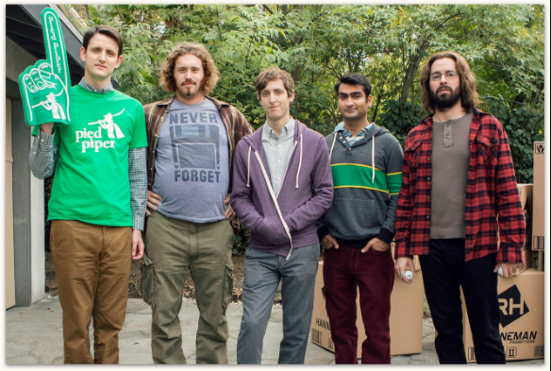
Getting into gear with Start-ups
Justin Kearns – Tucr.io
Notes:
HI everyone I’m Justin Kearns from Tucr.io
Hands up if you recognise these guys…
Yep these are the guys from Silicon velley
One of the best things to come out of the states in a long while.
I just love the series and in fact is you want to learn what it would be like to work at a start up then definitely watch it. It Is a lot closer tp reality than you would think. Minus all the venture capitalist throwing money at you…
So I ‘m the CEO and co-founder of Tucr, I’m technically Richard (but I cant code or at least I haven’t since college) but I do lead the strategic vision of the company and keep the team motivated so I guess I a bit like Ultich too.
Luckily I founded the company with our very own Gilfoil

Slide 2
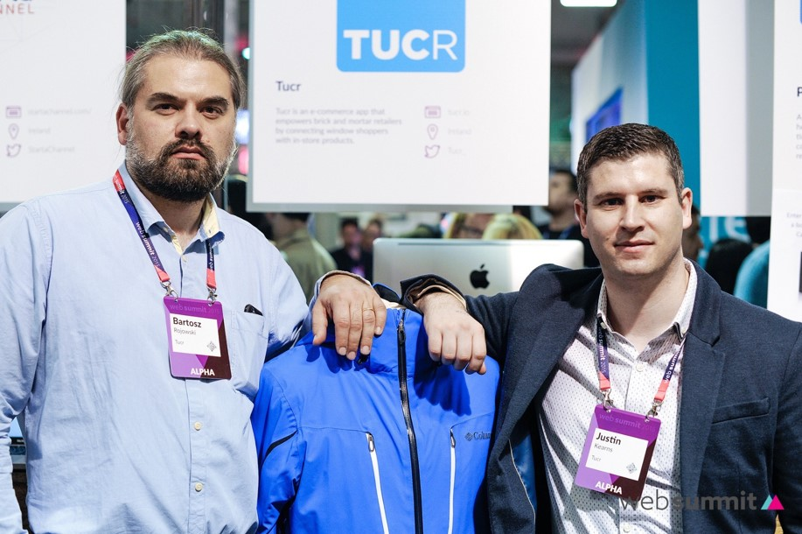
Notes:
Bart who is a skilled software developer and an experienced designer. Together we launched Tucr as a company at the 2015 Websummit to a great response. To be honest we were there with a prototype app, strong branding and plenty of promise. One thing we had that got peoples attention was a vision of creating change in how people pay for higher value items and services.

Slide 3
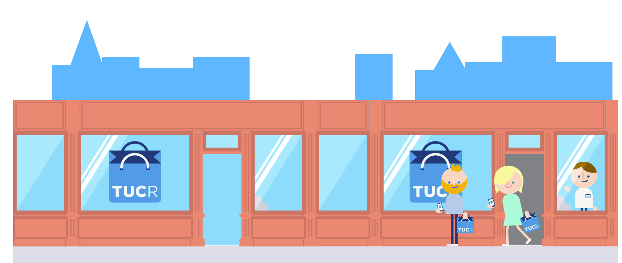
Tucr is a simple and secure way of reserving items and services with deposit payment
Notes:
We built a platform that simplifies how shoppers and retailers manage payment on items and services that have been reserved by a deposit.

Slide 4
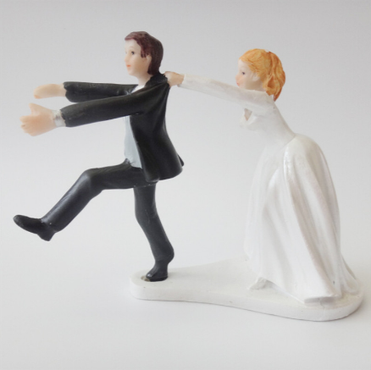





__________________________________
_________________
__________________________________
Notes:
People pay deposits all the time to reserve items and services. Whether it is to pre-order a the latest phone, to reserve a gift at Christmas time or for a higher value purchases that happen at milestone moments in people lives like weddings, new babies arriving or new family homes.
For example this time last year I collected and an engagement ring that I had reserved with a deposit in an jewellers. Thankfully she said yes and earlier this year together we paid a deposit to our wedding venue, wedding photographer, band and wedding rings. We did all of this through Tucr and we are also using Tucr to pay off the balance. You the moment we pay a deposit to a any business that uses our platform a digital receipt is sent tp the shopper and it is through this receipt that we can make follow up partial payment with our debit card when it suits us.

Slide 5
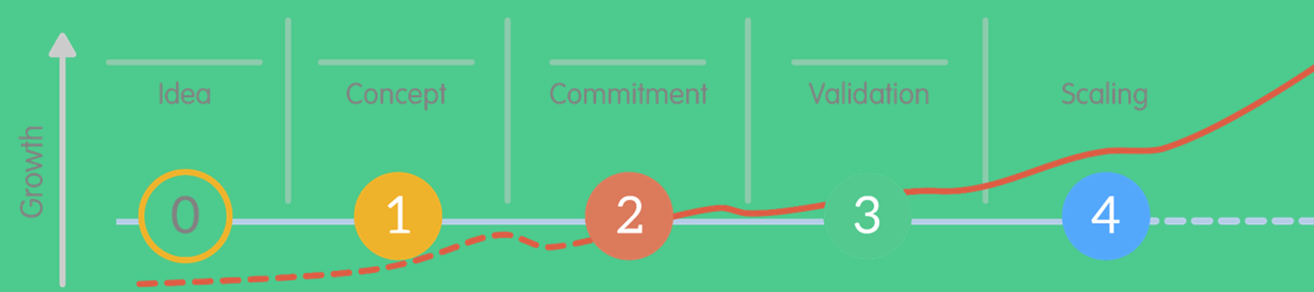
Milestones
May 2016 – Launched Public Beta
Sep 2016 – Enterprise Ireland CSF investment
Jan 2017 – Started Google Adopt a Start-up programme.
March 2017 – €250,000 items/service tuc’d away.
April 2017 – Integrated Tucr with Clover POS
Notes:
We launched our platform as a public beta last may and in the last 12 months we have had 250,000 worth if items and services that we tuc’d away with a deposit.
Enterprise Ireland have invested in the company through the first ever Fintech competitive start company. We were selected along side 29 other start ups to participate in the prestigious Google adapt a startup programme from Jane – April this year and we have just finished integrating Tucr with Clover who are a clover leader in retail software.

Slide 6
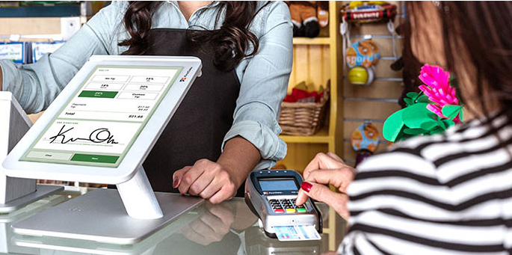
Available in 40+ countries and servicing 250,000 retailers
Clover -MPOS
Notes:
You will most likely have seen these tablets being used in local stores. Well chances are this it is a clover device. This integration brings us to the next stage of our growth and it’s a really exciting time. But before we got to this stag we have had a hell of a lot of ups and downs….running on minimal resources…trying to convince retailers to beta test our platform….trying to get those early users and build trust….then trying to convert them to paying customers to convince investors like enterprise Ireland that we are not just some crazy guys that can code.

Slide 7
Remind you of anything??
Notes:
Remind you of anything?

Slide 8
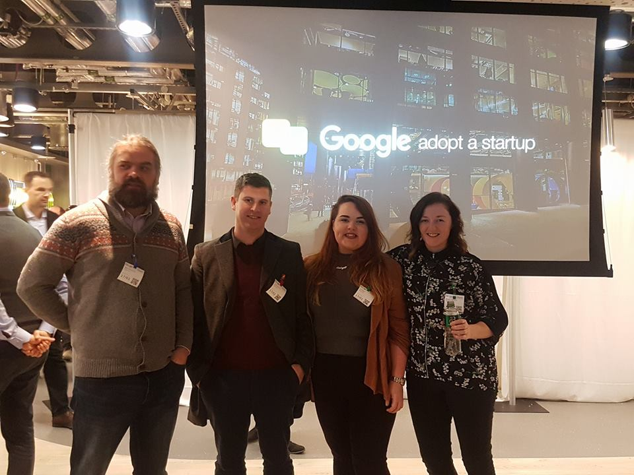
Fiction is not far from reality
Notes:
Yes fiction is not far from reality. Here’s 4/5ths of team tucr…the fifth member is David who is sitting here today..David came through your course last year and is currently doing his work placement at Tucr.

Slide 9
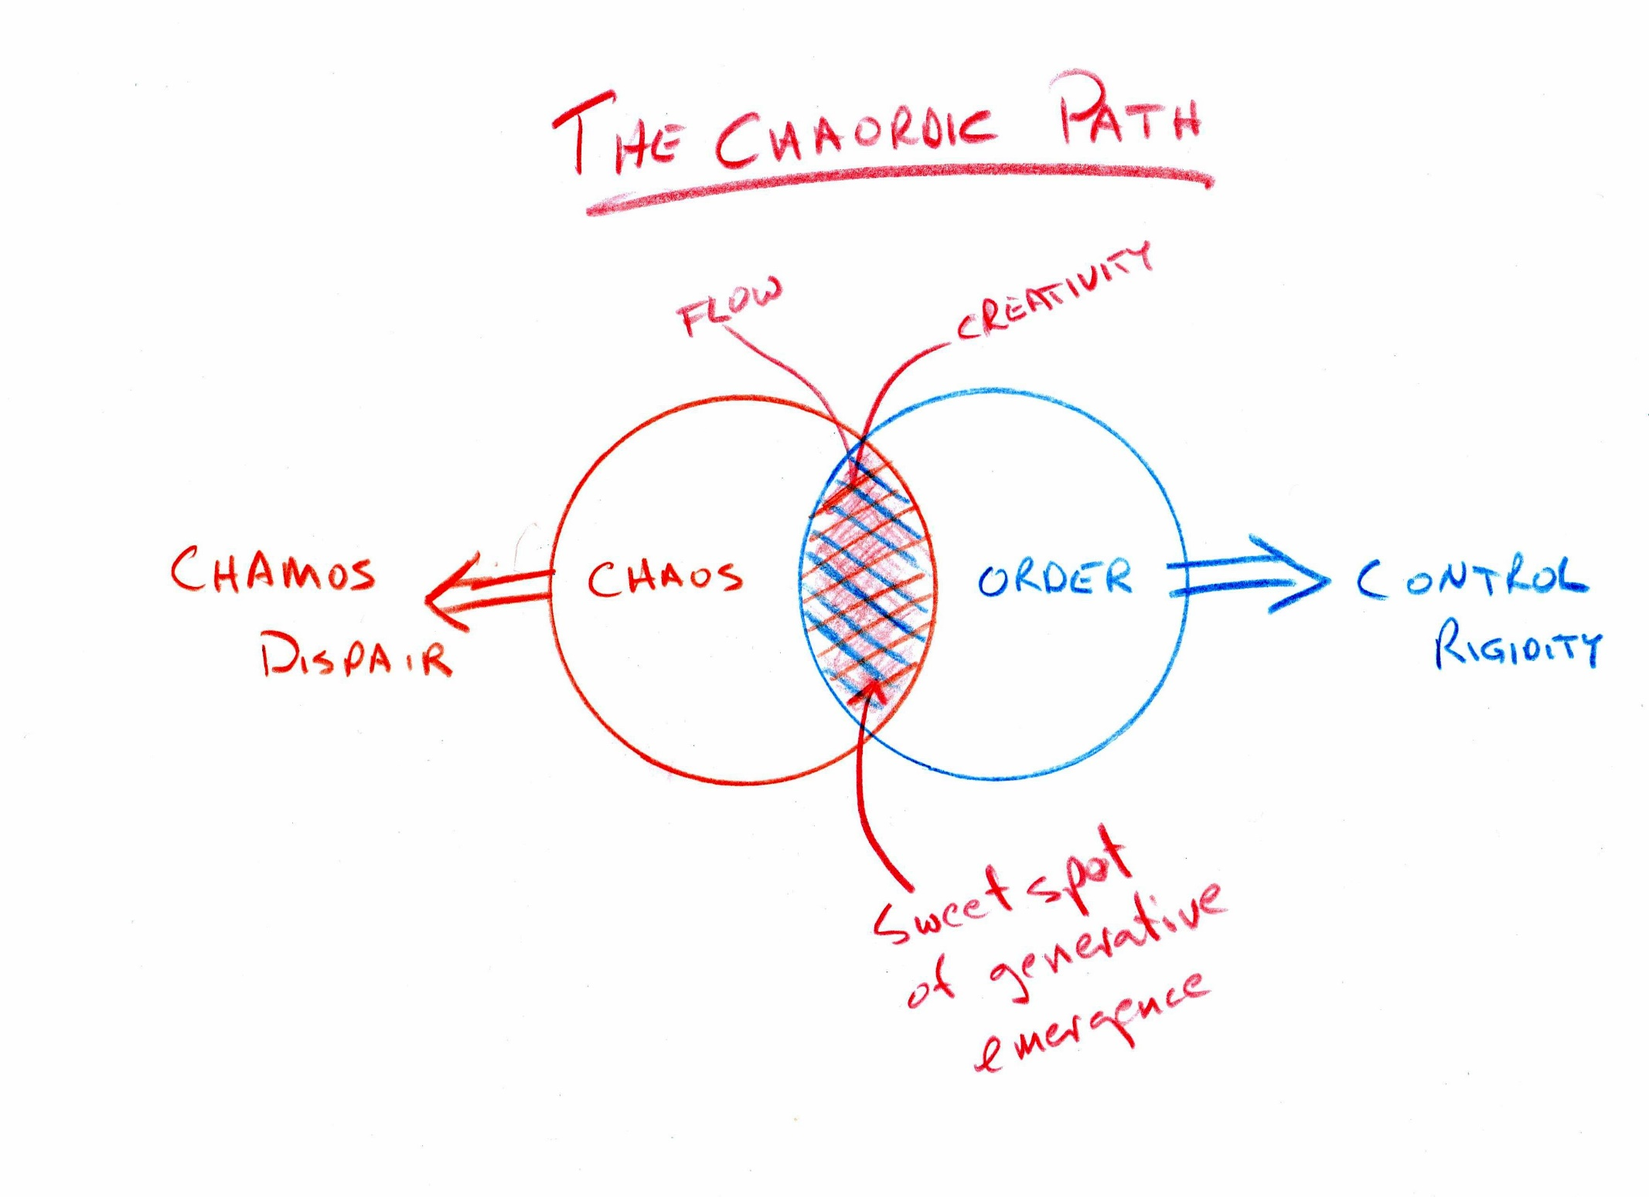
Organised Chaos
Dee W. Hock Founder Visa Credit Card Association
Notes:
David has had his taste of startup work…as an early stage company we live right about in here close to the edge as get and we slowly move towards this the sweet spot. Luckily this is a well worn path and there are some manuals to help guide us there.
“ Hire and promote first on the basis of integrity; second, motivation; third, capacity; fourth understanding; fifth, knowledge; and last and least, experience. Without integrity, motivation is dangerous; without motivation capacity is impotent; without capacity understanding is limited; without understanding, knowledge is meaningless; without knowledge, experience is blind. Experience is easy to provide and quickly put to good use by people with all the other qualities.”

Slide 10
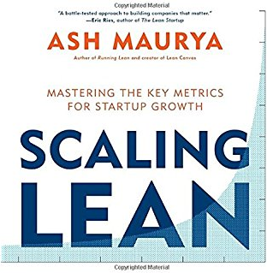
Notes:
For example running lean and scaling for lean two amazing books inspired by the founder of these guiding principles eric reeise with his book the lean startup.

Slide 11
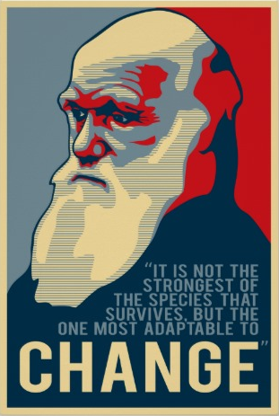
Notes:
One of the most important words in starups is ‘change’
Change is why I got into start-ups – not dreaming of getting rich, but to get the change to create something that can create change in this world.
Change is constant within startups too and this can be challenging for you if your new to this type of environment. Markets change over night and this means you are forced to change what you do and how you do it. Sometimes you hit a barrier in the market that you are trying to enter with a new product and if you are to stubborn to change tack or pivot then your business will die. You too as an early employee must be open to embracing this change and must be conformable working with change too. There will be tasks that in tech terms will may be well below your skill level. Like updating a wordpress site, hacking together 3rd party solutions to solve a problem in a very minimal way but the plus side is you can see how your work is impacting on the direction the company is moving, this give people a real purpose to their work.
For example we use wordpress for our marketing/sales website I come from a marketing background and so love using wordpress because it is great for digital marketing campaigns and is super easy for no technical for like me to work with. Bart our CTO despises wordpress, so Bart has been pushing us to move to boostrap for our sales site with a long while. So when we were creating a new product recently David volunteered to build it in bootstrap. This was a real eye opener for me. We worked together step by step to build it from the group up, for me it was like sitting with a graphic designed and mocking up a site to exactly how I wanted it to look. So thanks to Davids approach I changed how I view boostrap now, I can see how easy it is to work with so moving forward my preference is to build in boostrap and convert to wordpress. This gives the best of both worlds between the tech team and the commercial team.

Slide 12
WordPress
65%
25%
Developers hate WordPress
Sites across the world use WordPress
Notes:
According to a stackoverflow developers survey 65% of developers hate wordpress even tough 25% of all sites across the world are built in wordpress. Why is this…well firstly it is not very secure, die to its popularity and open source nature there are numerious back doors through tens of thousands of thirds party plugins that are available. But in all honesty I think it is because it goes against the very nature of how a developer thinks and approach's problem solving. So I may turn to bart or David and say ok I need target people who land our one of our blogs and then looks at our pricing tables. I want a pop up to appear that encourages them to schedule a demo. So the guys will get togheter, brainstorm a solution, search for some code our there that the can ‘borrow’ and try and make it work on our site. This is best case scenario. Worst case for me is they have to buld this themselves. Now this is probably a joy to them, wow we get to build something. But they reality is…all businesses not just startups, do not have time for this….wthin 2 minutrs I can go to google search for a wordpress plugin for this use case and install it in seconds and hey presto my request is granted. Now if things were so simple why do startups need skilled people like you. Well for mission critical use cases that are the core of the business this is where custom build from the ground up delivers a competitive advantage for the business in the market. I am a big fan though of using the most simplest tools to prove that there is merit in building out a product this is the lean approach.
So why is this important for you to know. Well if you are targeting a job at a start up. Particularly placement at an early stage start-up. This give you an edge.
Yes it is great if you

Slide 13
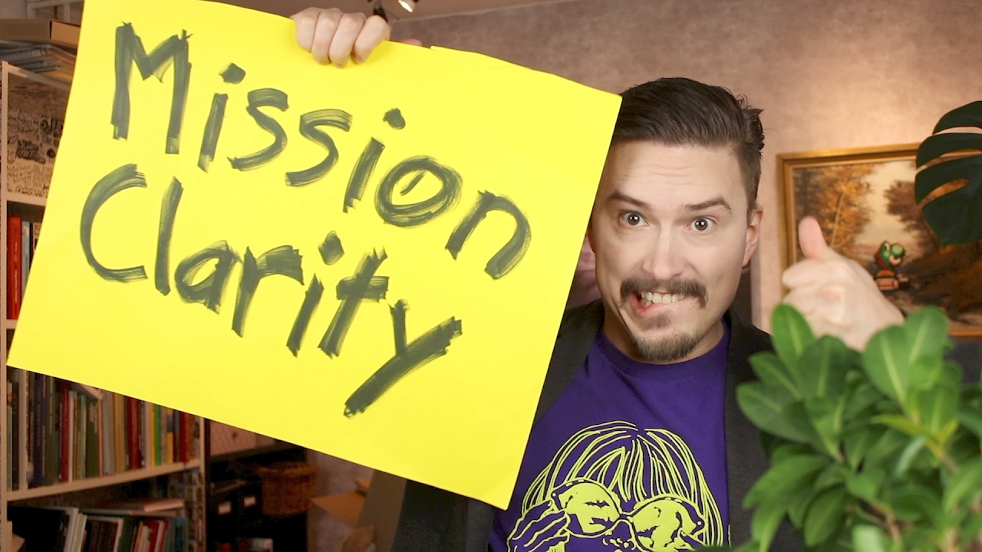
Why?
Notes:
https://youtu.be/XQCsOymE2mE 3m 50 or 9:20sec - 10:41 12 30 – 13:00
So yes it is really important that can step up and take initiative like David did and its important that people like me listen closely to what our devs have to say and empower them to become leaders.

Slide 14

Notes:
Now ill take you through some of the tech we use. We use laravel which is a PHP framework primarily because Bart is a PHP developer. Its good for early stage start-up companies because it enables them to create a working minimal viable product and test it in the market in a short period of time with limited resources. Laravel uses MVC model view controller which is something I think you will become familiar with next year.

Slide 15


Vue.js
Notes:
Since David joined our team we were at a stage when we wanted to move away from our MVP and start putting in place a product that was scalable. So we started working on a single page application using Vue.Js we at the time we were considering Angular but instead decided to go for Vue because.
It is a light weight “version” of angular js. - It is faster than any other javvascripts framework. - It uses virtual DOM - It has a growing community = It is reactive. – IT keeps the data in sync and replaces jquery - This means Our application will be more fluid – intuitive.

Slide 16
Tools we use
Software & Hardware
Marketing / Sales
Intercom / Wordpress / Mail Chimp / Mail Gun / Hubspot / Typeform
Slack / Trello
Github / Digital Ocean / Filezilla
Subline Text / Atom / PHP Storm
Vagrant / Laravel Valet /Bit Bucket
Comms & Project Management

Slide 17
Why Start-up's?
You can see the difference you are making in peoples lives.
You will learn a hell of a lot in a short time.
Big opportunities for career growth.
Beer, Pizza and cool people…

Slide 18
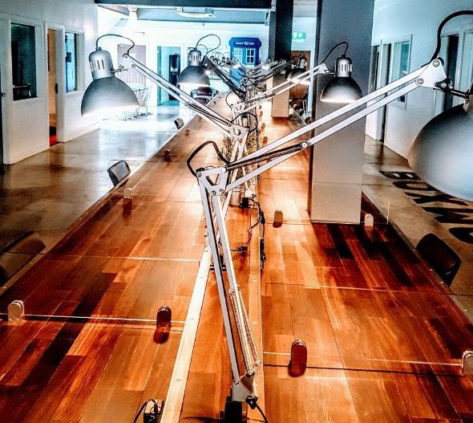
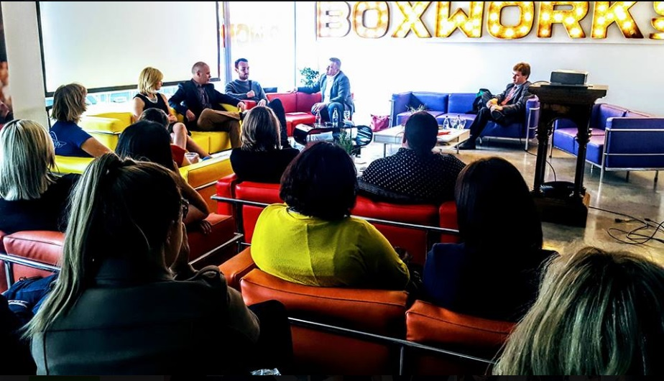
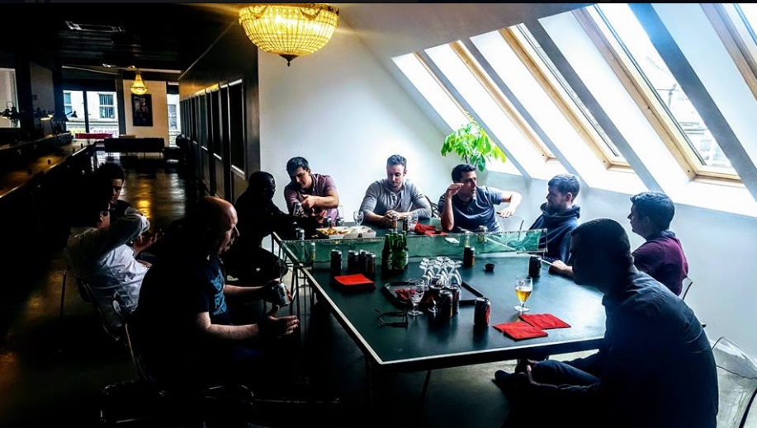
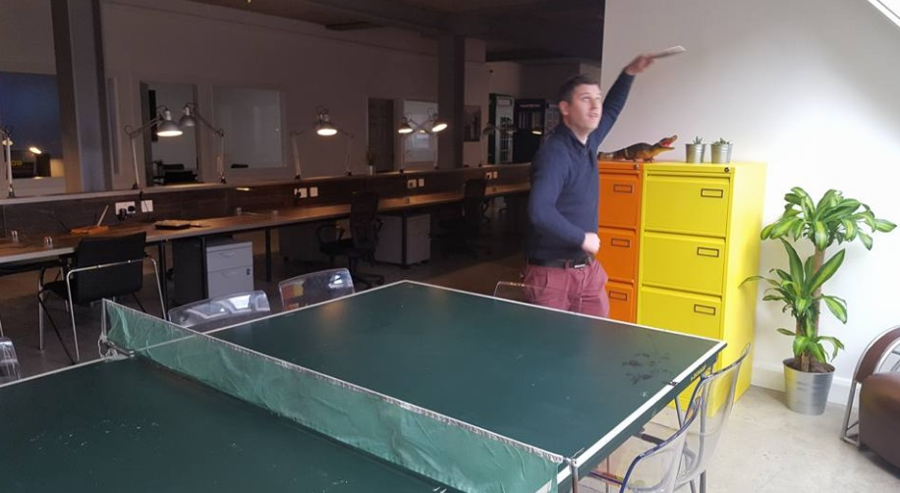
Notes:
To create change I really believe we must create an environment where people can flourish…that’s why we have some of the stereo typical things you would come to expect such as a ping pong table which doubles up as a beer table on the occasional Friday evening.

Slide 19
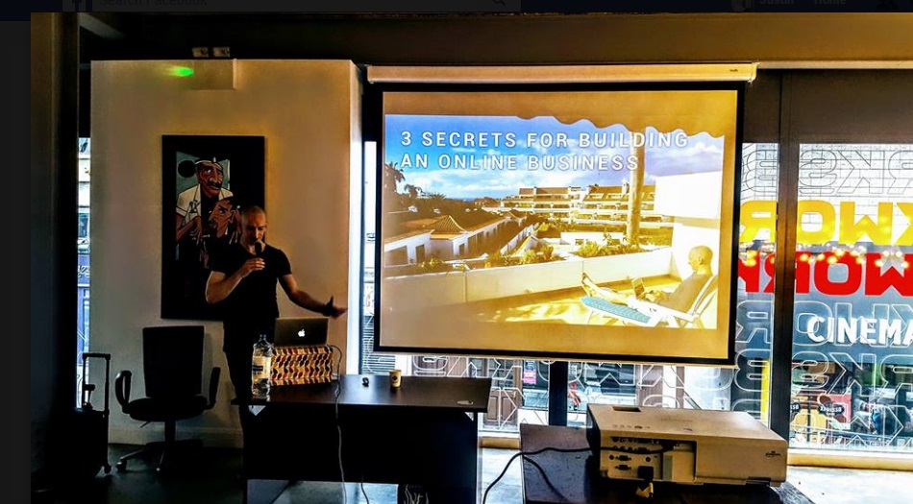
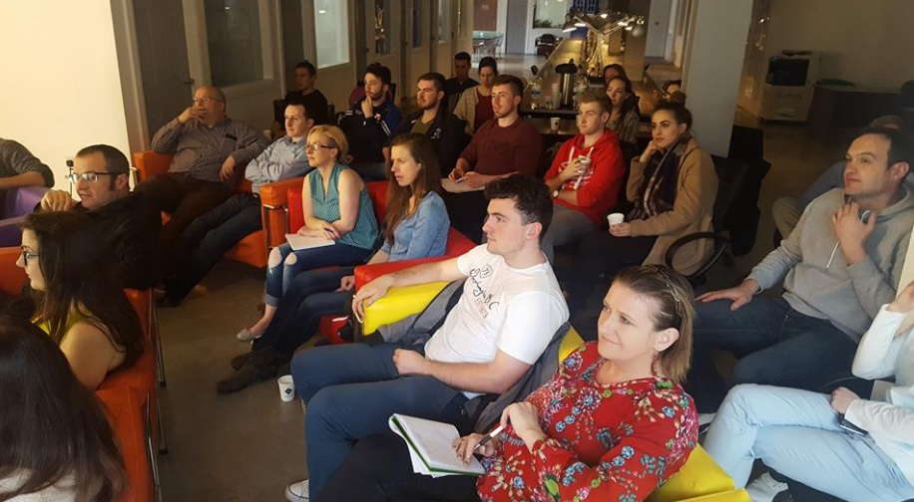
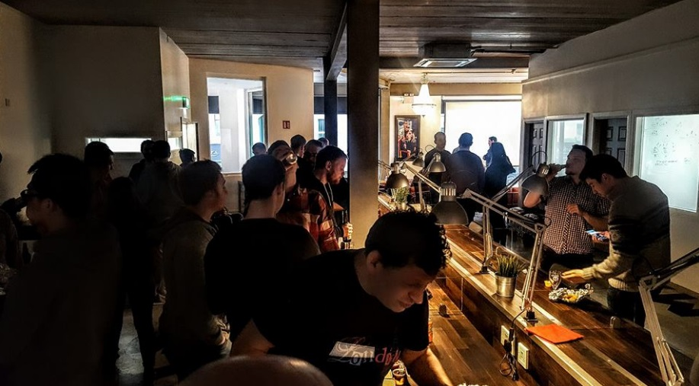
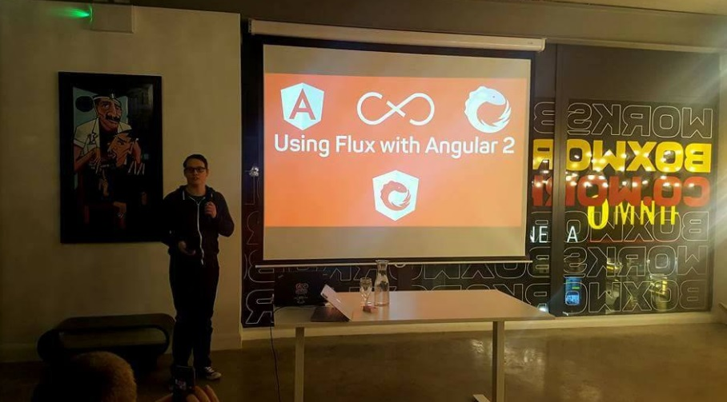
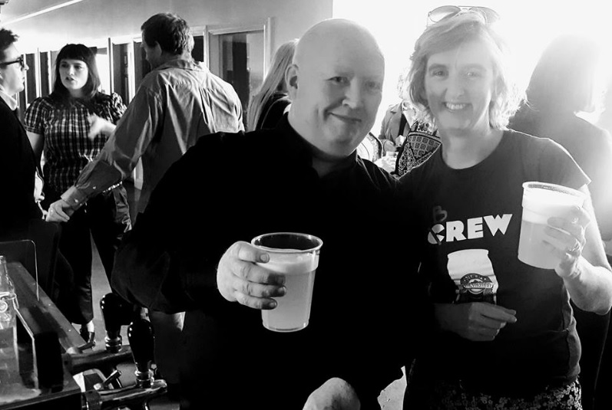
Notes:
We a blessed to have access to some really interesting events that frequently happen like Waterford tech meet up and various different tech and business related events.

Slide 20
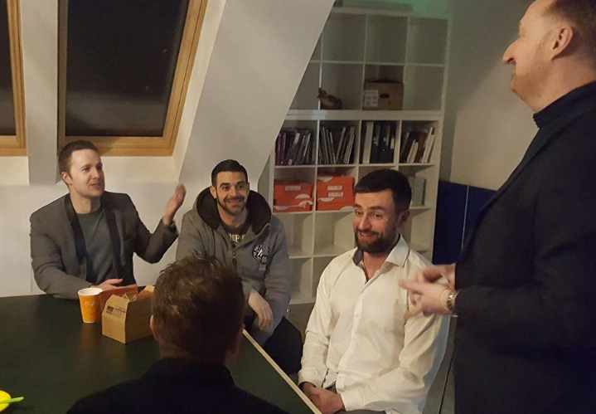
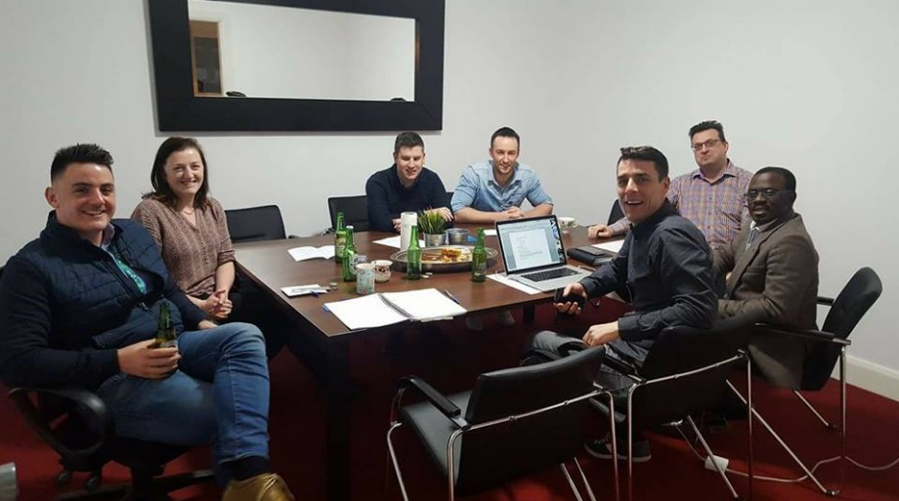
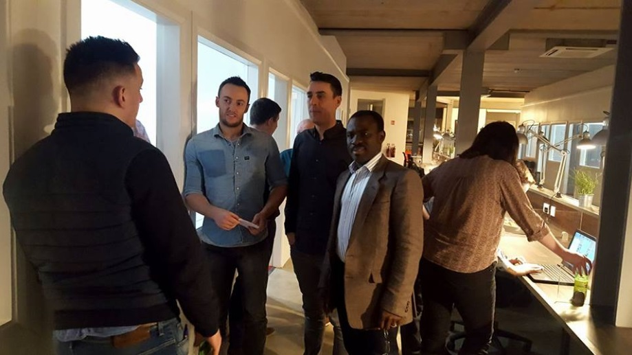
Notes:
But the best of all really for a start-up like us is the social element. Meeting like minded people in a creative space, helps breathe a successful and happy team.

Slide 21


Thank You
Tucr
T: +353 (0)51 3640132
E: justin@tucr.io
W: www.tucr.io
: @Tucr_
A simple & secure way to reserve items and services

